Slide 1

Master’s Thesis
Development of a Voice Assistant Application
Submitted BY ABHIJITH PAVITHRAN
MASTER OF ENGINEERING IN INFORMATION TECHNOLOGY
SRH HOCHSCHULE HEIDELBERG , GERMANY
11018118@STUD.HOCHSCHULE-HEIDELBERG.DE
MATRICULATION NO : 11018118

Slide 2
Agenda
Voice Assistant Application Overview
Design Phase
Dialogue acts and dialogue domain key words
Implementation
Demonstration
Evaluation
Conclusion
Future Scope

Slide 3
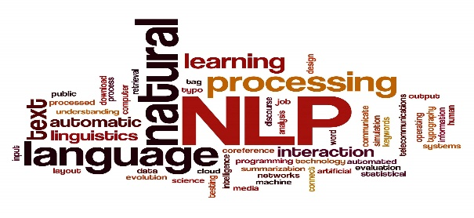


Voice Assistant Overview
Thesis Focus: Developing a user-driven voice assistant application using Jupyter Notebook.
Key Features:
User-initiated interactions.
Spoken commands and questions.
Enhancing tech accessibility.
Advantages:
Users can quickly perform actions, reducing the time spent on manual tasks.
Users can perform tasks while keeping their hands free.
The voice assistant can provide entertainment through jokes, playing music, etc.

Slide 4
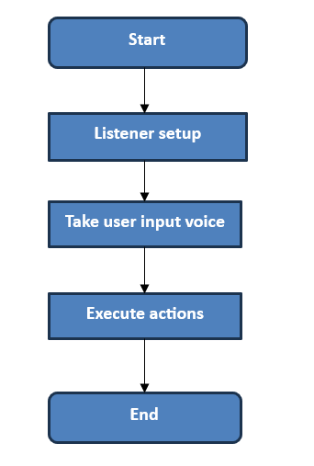
Design Phase
The basic workflow of a voice assistant application typically involves the following components and their interactions:
Listener Setup:
Used for configuring the speech recognition system to capture and process the user's voice input.
Take user input voice:
This component captures the user’s input voice and transcribes it into text using speech recognition techniques.
Execute Actions:
The "Execute Actions" component interprets and executes the recognized user commands or questions.

Slide 5
Dialogue domain keywords and dialogue acts
Dialogue domain key words | Dialogue acts
In voice assistant applications, understanding user intent is crucial. Dialogue domain keywords play a pivotal role in this process. Here is the list of some keywords that are defined to perform various actions: play: Initiates playing content on YouTube. time: Requests the current time. weather: Inquires about today's weather forecast. | In the realm of voice interactions, understanding not just what users say but also what they intend to do is essential. This is where dialogue acts come into importance. These are the intentions that the developed voice assistant recognizes from user inputs. “Question" for asking for information. Eg: What is the time now? 2. "Command" for giving direct commands. Eg: Play a bollywod song in Youtube.

Slide 6
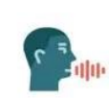
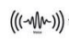
Implimentation
Audio input
Microphone
Python Packages
Speech recognition
Speech output
Input interpretation
Input extraction
Perform Actions
6

Slide 7


Python and Key Packages
Speech recognition - Enables the voice assistant to convert spoken words into text.
Pyttsx3 - To respond to user commands in a natural and human-like manner:
Pyhatkit - To access YouTube.
Datetime - To enable current date and time.
Wikipedia - To access Wikipedia information.
OS module - To perform OS related tasks such as opening word, excel etc.
Ecapture - To capture image using webcam.

Slide 8
Demonstration
The keywords and actions
play: Initiates playing content on YouTube.
joke: Requests a joke to be told.
open google: Opens the Google website.
word: Opens Microsoft Word.
excel: Opens Microsoft Excel.
shut down: Initiates a computer shutdown.
Wikipedia: Requests information from Wikipedia.
camera or take a photo: Capture
exit: Exits the voice assistant application.

Slide 9
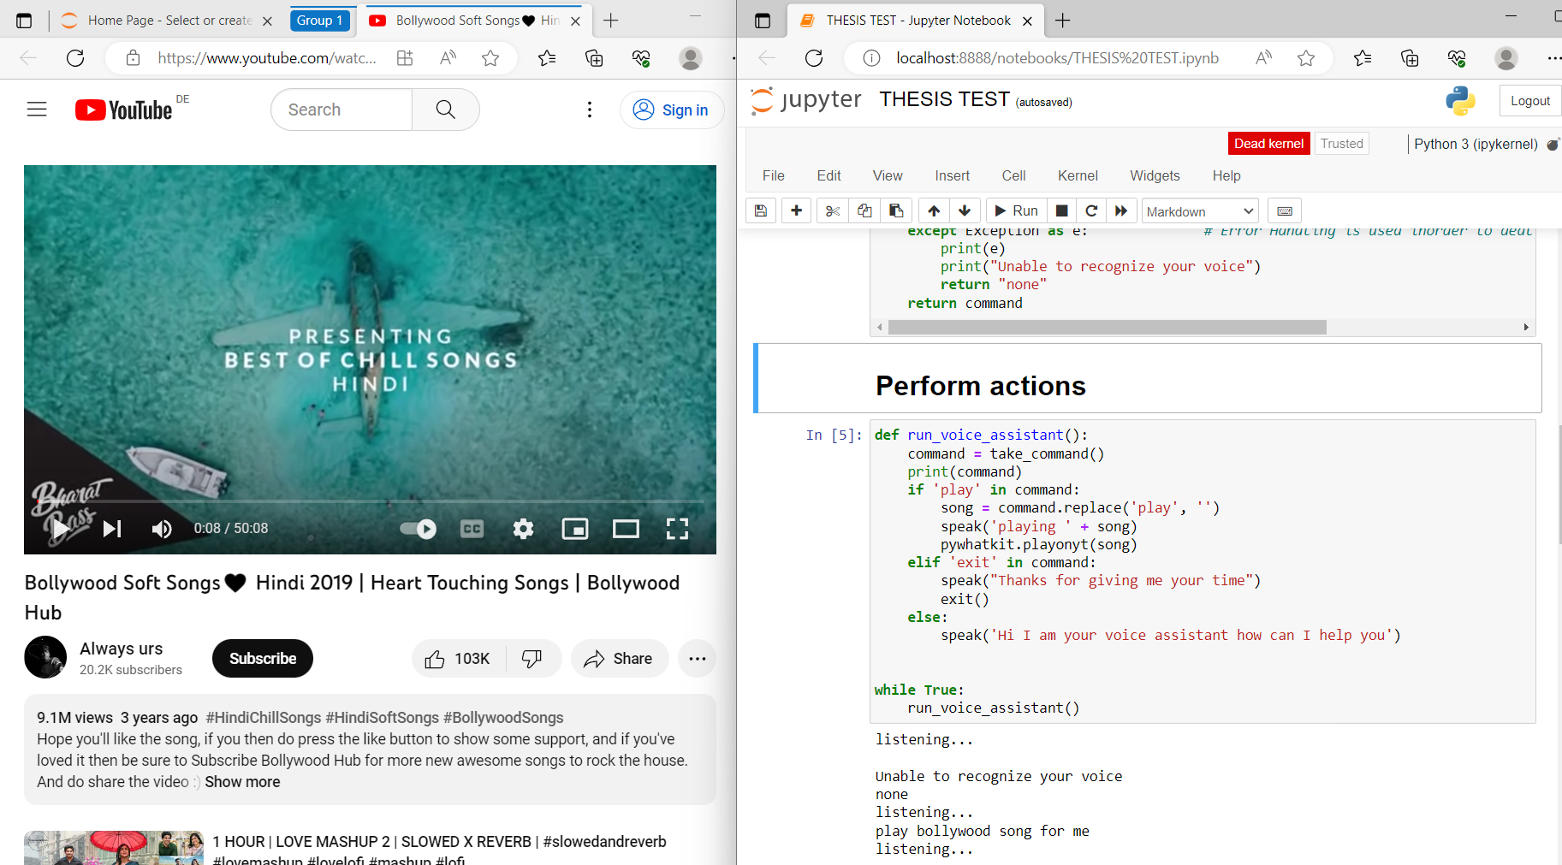
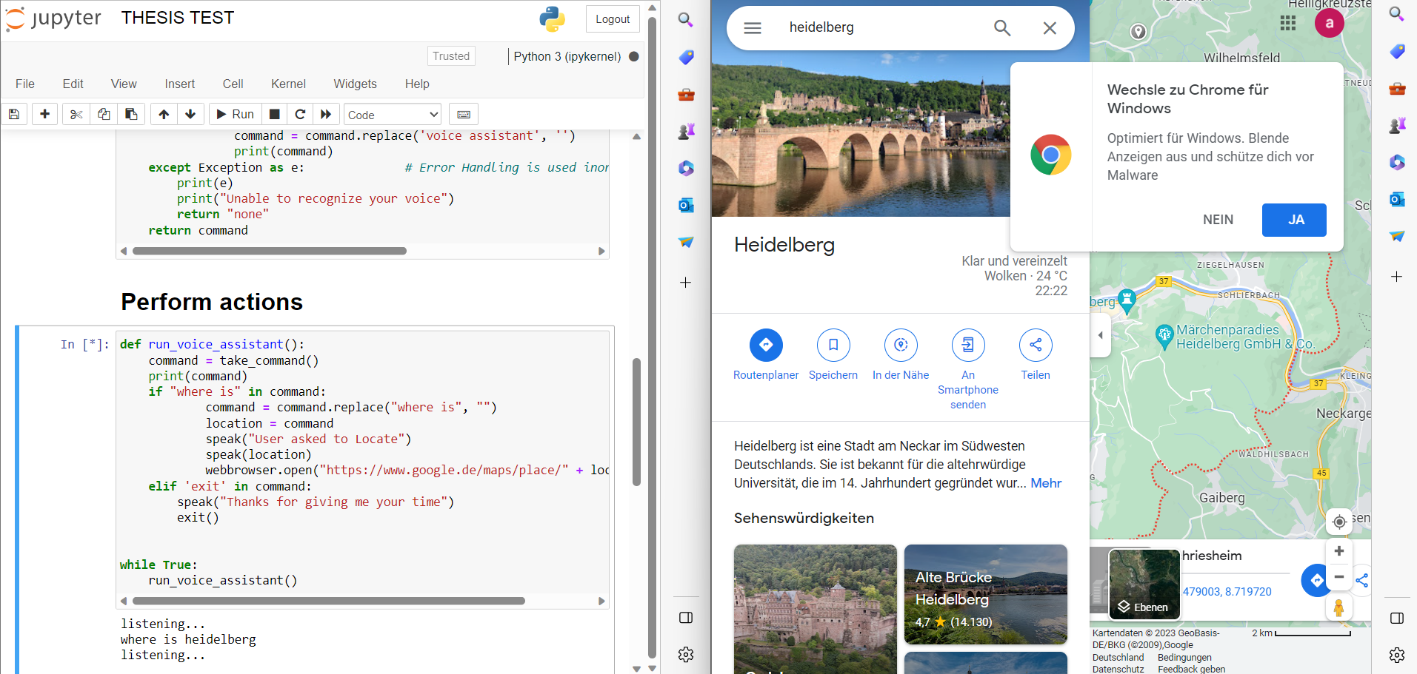
1. Playing bollywood song using the Application
2. Maping using the developed application

Slide 10
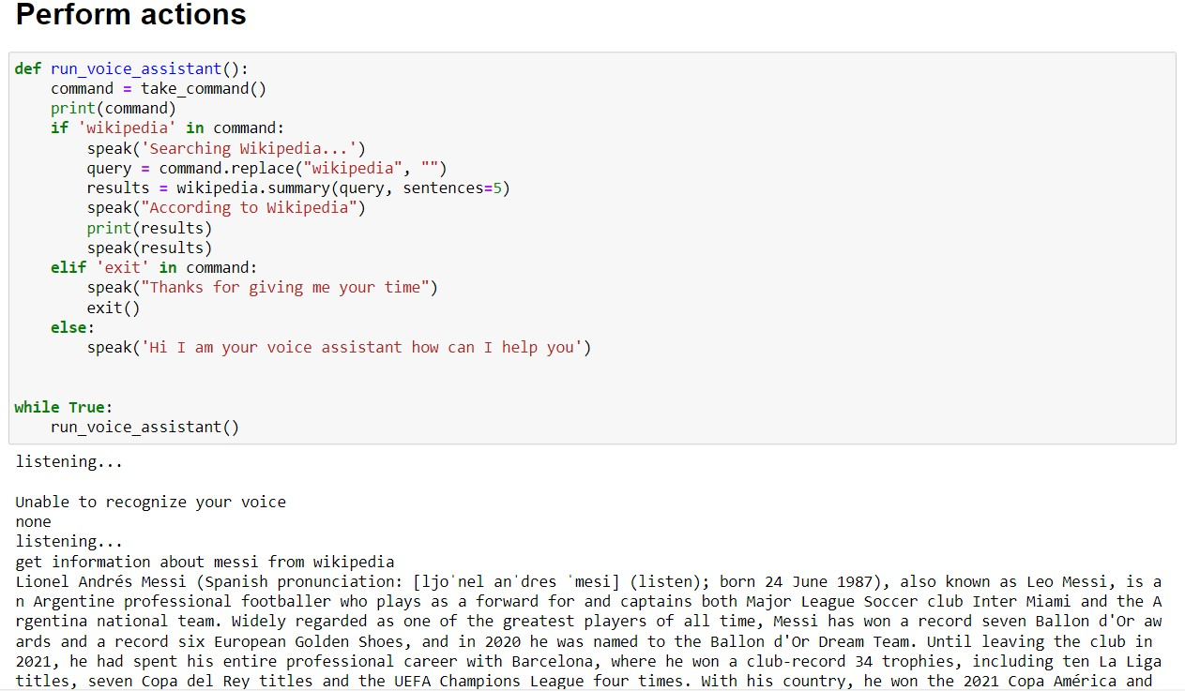
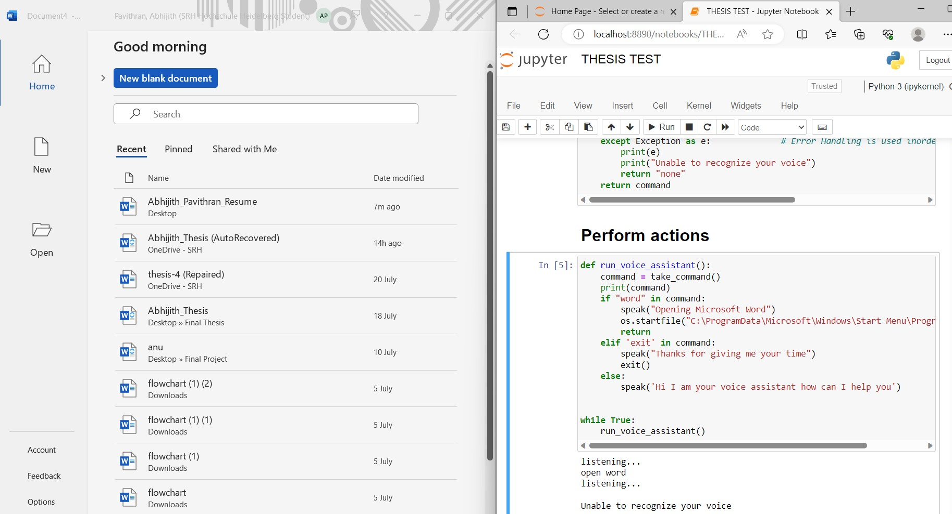
3. Obtaining the information from Wikipedia
4. Opening Microsoft Word Application using the Application

Slide 11
Evaluation of the developed Application
Testing Process: The voice assistant application underwent evaluation with six naive subjects who interacted independently, providing spontaneous input.
Response Grading:
Grade 1: Accurate and Complete Information
Grade 2: Partially Correct Information
Grade 3: Inaccurate Responses
Performance Overview:
The voice assistant exhibited reasonable performance across subjects.
Average Mean Grade: 1.83
Variability Analysis:
Standard Deviation: 0.82
This evaluation demonstrates the application's ability to understand and respond to user interactions effectively.

Slide 12

Evaluating Dialogue Act Responses
Understanding Versatility: Assessing how the voice assistant responds to diverse dialogue acts.
Varied Interactions: Examination of interactions involving commands and questions.
Preference for Commands: Subjects generally preferred using commands for actions and information.
Inaccuracy Instances: Some commands and questions yielded inaccurate responses

Slide 13

Conclusion
Achieving the Vision
Successfully designed, implemented, and evaluated a voice assistant application.
Strengths
Proficiency in understanding and executing commands or questions.
Integration with user-initiated interactions.
Areas for Improvement
Minor inaccuracies and misunderstandings.
Enhancing natural language processing and context understanding.

Slide 14
Future Scope
Personalization based on the history of user inputs.
Multilingual support for global accessibility.
Integration with IoT devices and third-party services like booking movie tickets, ordering foods.
Emotion and sentiment analysis based on speech patterns.
Strengthened security and privacy measures.
Email and communication integration.

Slide 15
Thank you for your attention

